Slide 1
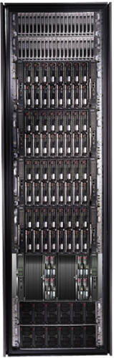
Data-Intensive Cluster Computing
Mihai Budiu
Microsoft Research, Silicon Valley
SJSU Cloud Computing Course September 21, 2011

Slide 2
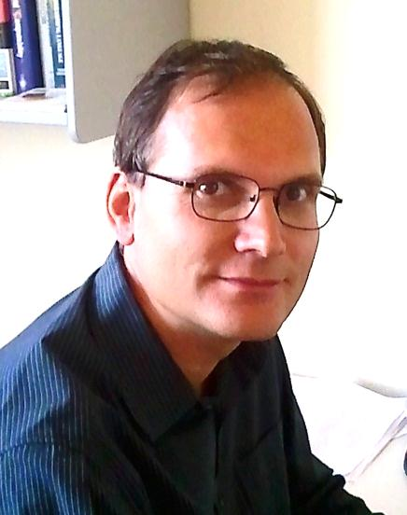
About Myself
Researcher at Microsoft Research in Mountain View
Ph.D. in Computer Science from Carnegie Mellon, 2004
Worked on reconfigurable hardware, compilers, security, cloud computing, performance analysis
I worked on most software layers that I am presenting today

Slide 3

Lessons to remember
Will use this symbol throughout the presentation to point out fundamental concepts and ideas.
This talk is not about products. It is a talk about principles, illustrated with some products.

Slide 4


Big Data

Slide 5
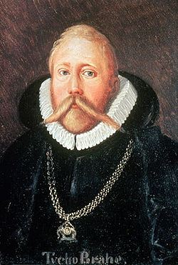
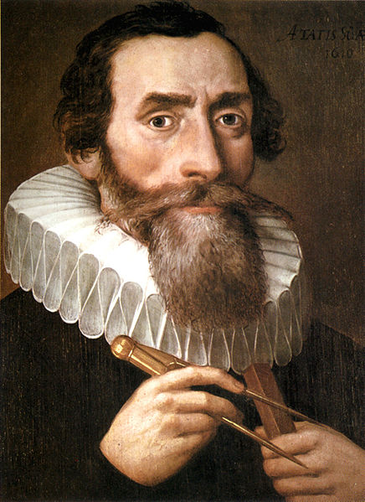
500 Years Ago
Tycho Brahe (1546-1601)
Johannes Kepler
(1571-1630)
Notes:
Images from Wikipedia

Slide 6
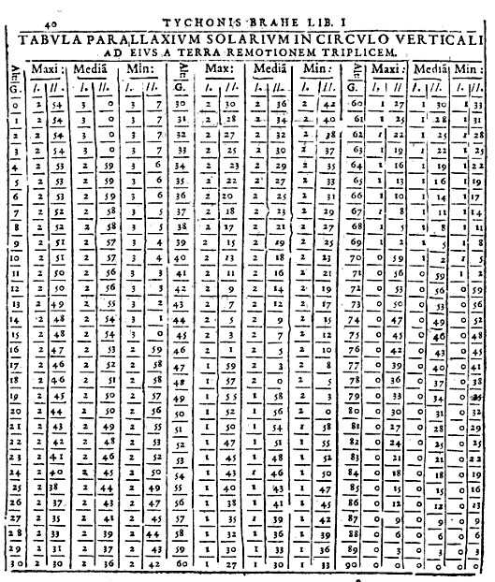
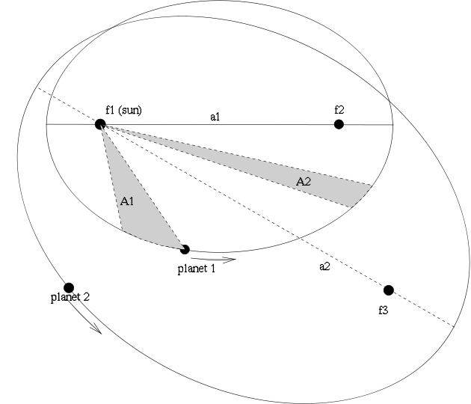
The Laws of Planetary Motion
Tycho’s measurements
Kepler’s laws
Notes:
Left image from Google Books.
Right image from Wikipedia.

Slide 7
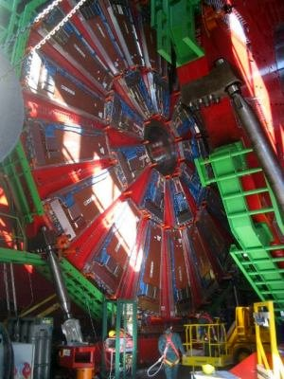
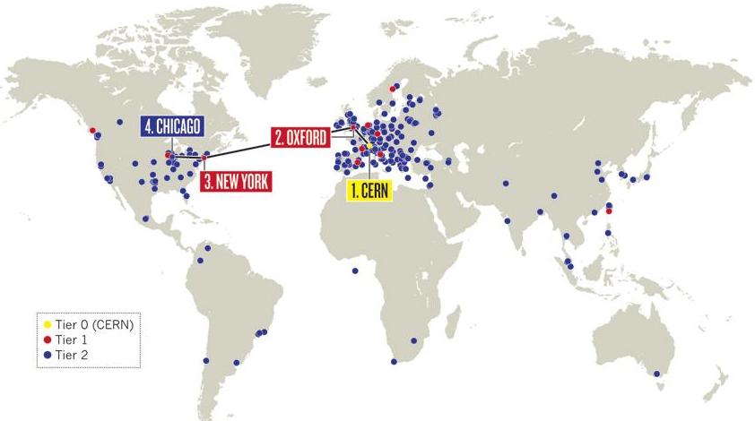
The Large Hadron Collider
LHC Grid: 200K computing cores
15 PB/year
Notes:
Left image from Wikipedia.
Right image from Nature.com

Slide 8
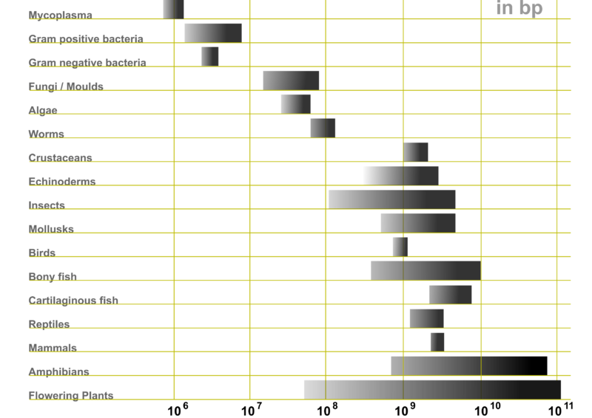
Genetic Code
Notes:
Image from Wikipedia

Slide 9
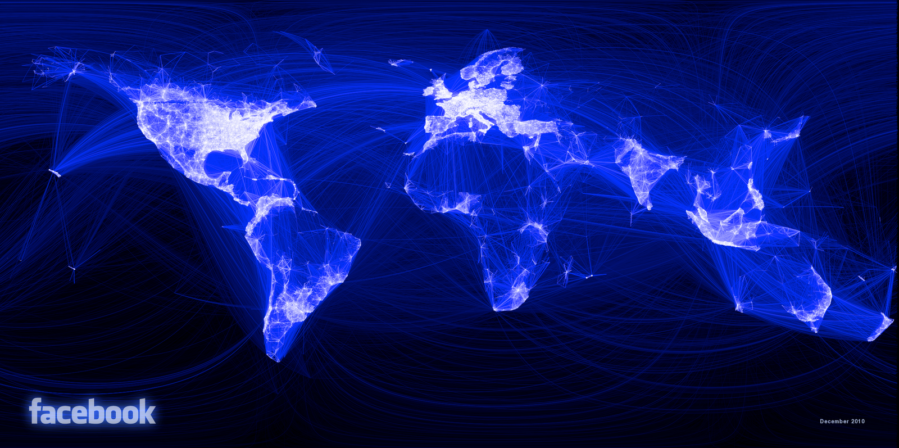
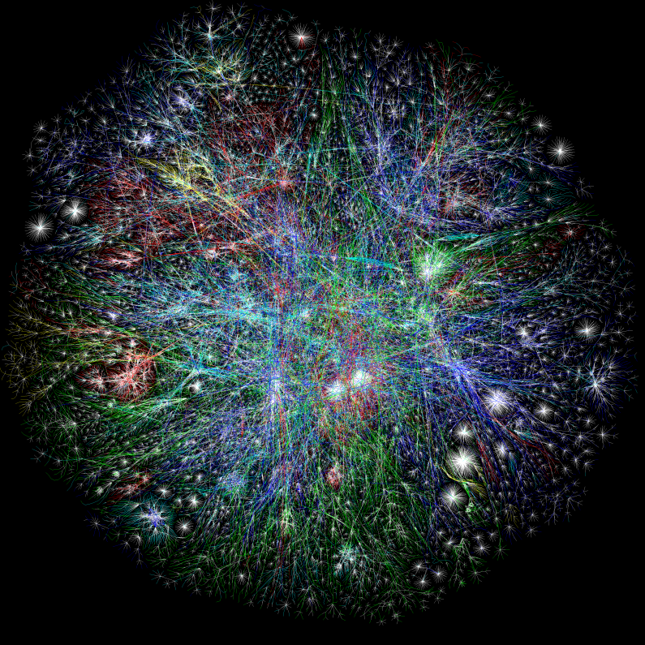
The Webs
Facebook friends graph
Internet
Notes:
Left image from Opte.org
Right image from facebook.com

Slide 10

Big Data

Slide 11


Big Computers

Slide 12
Crunching Big Data
Big Dat

Slide 13
Design Space
Grid
Internet
Data-
parallel
Search
X
Shared
memory
Data
center
Transaction
HPC
Latency
(interactive)
Throughput
(batch)
Notes:
Dryad is optimized for: throughput, data-parallel computation, in a private data-center.

Slide 14
Software Stack
Applications
Language (LINQ To HPC)
Execution (Dryad)
Storage (Distributed Storage Catalog)
Higher abstractions
Cluster Management (Windows HPC Cluster)
Virtual Machine (Windows Azure)
Windows Server
Windows Server
Windows Server
Windows Server

Slide 15
Data-Parallel Computation
Application
SQL
Sawzall, Java
≈SQL
LINQ, SQL
Parallel Databases
Sawzall,FlumeJava
Pig, Hive
L2H Scope
Language
Map-Reduce
Hadoop
Dryad
Execution
GFS BigTable
HDFS
DSC
Storage

Slide 16
Modularity pays off
Entire stack easily ported to new runtimes
HPC, Cosmos, Azure
Clean language/runtime separation
Allowed new languages to reuse stack: Scope, LINQ to HPC

Slide 17

A Brief History
Google Map-Reduce paper published
Google File-System paper published
DryadLINQ becomes LINQ to HPC
Dryad deployed by Live search
DryadLINQ paper published
Dryad paper published
Amazon EC2 launched
Hadoop created
L2H beta2
2003
2004
2006
2007
2008
2010
2011

Slide 18
Cluster Architecture
Applications
Language
Distributed Execution
Cluster storage
Cluster services
Health service
Windows Server
Windows Server
Windows Server
Windows Server

Slide 19
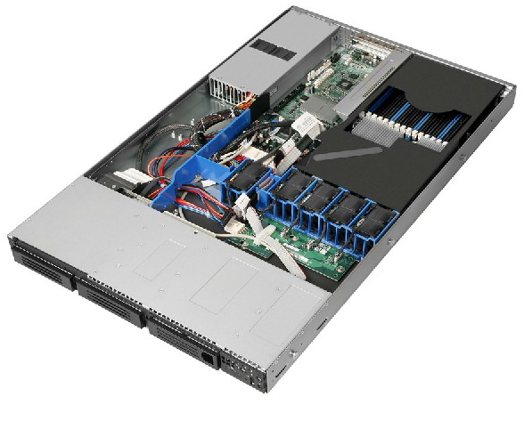
Cluster Machines
Commodity server-class systems
Optimized for cost
Remote management interface
Local storage (multiple drives)
Multi-core CPU
Gigabit Ethernet
Stock Windows Server

Slide 20
Cluster network topology
To next level switch
top-level switch
top-of-rack switch
rack

Slide 21
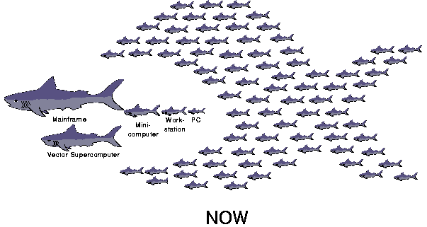
The secret of scalability
Cheap hardware
Smart software
Berkeley Network of Workstations (’94-’98) http://now.cs.berkeley.edu

Slide 22
Health Service: Autopilot
Applications
Language
Distributed Execution
Cluster storage
Cluster services
Health service
Windows Server
Windows Server
Windows Server
Windows Server
(A tiny part of Azure)

Slide 23


Autopilot goal
Handle automatically routine tasks
Without operator intervention

Slide 24

Autopiloted System
Autopilot control
Application
Autopilot services

Slide 25
Recovery-Oriented Computing
Everything will eventually fail
Design for failure
Crash-only software design
http://roc.cs.berkeley.edu
Brown, A. and D. A. Patterson. Embracing Failure: A Case for Recovery-Oriented Computing (ROC). High Performance Transaction Processing Symposium, October 2001.

Slide 26

Autopilot Architecture
Discover new machines; netboot; self-test
Install application binaries and configurations
Monitor application health
Fix broken machines
Operational data collection and visualization
Provisioning
Deployment
Watchdog
Repair
Device Manager

Slide 27
Distributed State
Distributed state
Replicated
Weakly consistent
Provisioning
Deployment
Watchdog
Repair
Device Manager
Centralized state
Replicated Strongly consistent

Slide 28
Centralized Replicated Control
Keep essential control state centralized
Replicate the state for reliability
Use the Paxos consensus protocol
Leslie Lamport. The part-time parliament. ACM Transactions on Computer Systems, 16(2):133{169, May 1998.
Paxos

Slide 29


Consistency Model
Strong consistency
Expensive to provide
Hard to build right
Easy to understand
Easy to program against
Simple application design
Weak consistency
Increases availability
Many different models
Easy to misuse
Very hard to understand
Conflict management in application

Slide 30
Autopilot abstraction
Self-healing machines
Health service
Windows Server
Windows Server
Windows Server
Windows Server

Slide 31
Cluster Services
Applications
Language
Distributed Execution
Cluster storage
Cluster services
Health service
Windows Server
Windows Server
Windows Server
Windows Server
(A tiny part of Windows HPC Cluster)

Slide 32
Cluster Machines
Remote execution
Storage
Remote execution
Storage
Storage metadata
Name service
Scheduling
Paxos

Slide 33
Cluster Services
Name service: discover cluster machines
Scheduling: allocate cluster machines
Storage metadata: file location
Storage: file contents
Remote execution: spawn new computations

Slide 34
Cluster services abstraction
Reliable specialized machines
Cluster services
Health service
Windows Server
Windows Server
Windows Server
Windows Server

Slide 35

Layered Software Architecture
Simple components
Software-provided reliability
Versioned APIs
Design for live staged deployment

Slide 36
Cluster Storage: Distributed Storage Catalog
Applications
Language
Distributed Execution
Cluster storage
Cluster services
Health service
Windows Server
Windows Server
Windows Server
Windows Server

Slide 37
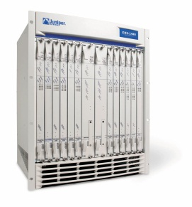
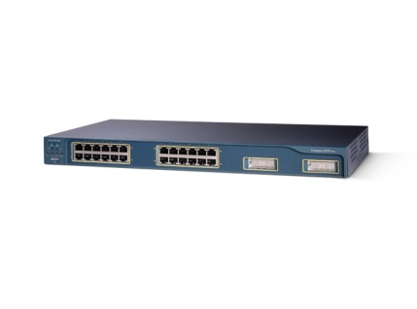
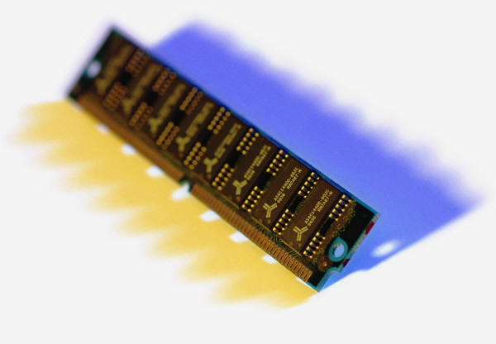
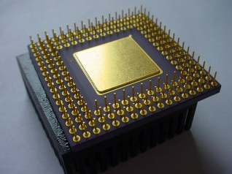
Bandwidth hierarchy
Cache
RAM
Local disks
Local rack
Remote rack
Remote
datacenter

Slide 38
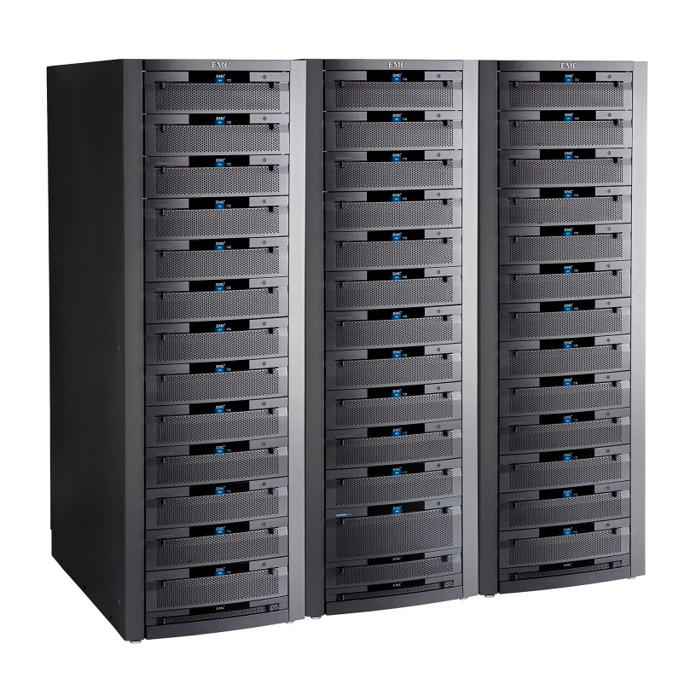
Storage bandwidth
Expensive
Fast network needed
Limited by network b/w
SAN
Cheap network
Cheap machines
Limited by disk b/w
JBOD

Slide 39
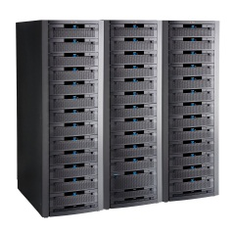
Time to read 1TB (sequential)
1 TB / 100MB/s = 3 hours
1 TB / 10 Gbps = 40 minutes
1 TB / (50 MB/s/disk x 10000 disks) = 2s
(1000 machines x 10 disks x 1TB/disk = 10PB)

Slide 40
Large-scale Distributed Storage
F[1]
File F
F[0]
F[1]
F[0]
Storage metadata service
Storage
Storage
Storage

Slide 41
Parallel Application I/O
App ctrl
App
App
lookup
File F
F[0]
F[1]
Storage metadata service
Storage
Storage
Storage

Slide 42
Cluster Storage Abstraction
Set of reliable machines with a global filesystem
Cluster storage
Cluster services
Health service
Windows Server
Windows Server
Windows Server
Windows Server

Slide 43
Distributed Execution: Dryad
Applications
Language
Distributed Execution
Cluster storage
Cluster services
Health service
Windows Server
Windows Server
Windows Server
Windows Server

Slide 44
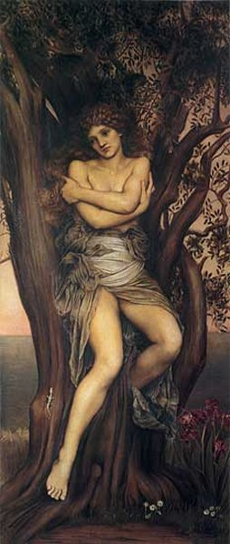
Dryad
Execution layer of Bing analytics
Continuously deployed since 2006
Running on >> 10⁴ machines
Sifting through > 10Pb data daily
Runs on clusters > 3000 machines
Handles jobs with > 10⁵ processes each
Platform for rich software ecosystem
The Dryad by Evelyn De Morgan.

Slide 45
Dryad = Execution Layer
Job (application)
Pipeline
≈
Dryad
Shell
Cluster
Machine
Notes:
In the same way as the Unix shell does not understand the pipeline running on top, but manages its execution (i.e., killing processes when one exits), Dryad does not understand the job running on top.

Slide 46
2-D Piping
Unix Pipes: 1-D
grep | sed | sort | awk | perl
Dryad: 2-D
grep¹⁰⁰⁰ | sed⁵⁰⁰ | sort¹⁰⁰⁰ | awk⁵⁰⁰ | perl⁵⁰
Notes:
Dryad is a generalization of the Unix piping mechanism: instead of uni-dimensional (chain) pipelines, it provides two-dimensional pipelines. The unit is still a process connected by a point-to-point channel, but the processes are replicated.

Slide 47
Virtualized 2-D Pipelines
Notes:
This is a possible schedule of a Dryad job using 2 machines.

Slide 48

Virtualized 2-D Pipelines

Slide 49

Virtualized 2-D Pipelines

Slide 50
Virtualized 2-D Pipelines

Slide 51
Virtualized 2-D Pipelines
2D DAG
multi-machine
virtualized
Notes:
The Unix pipeline is generalized 3-ways:
2D instead of 1D
spans multiple machines
resources are virtualized: you can run the same large job on many or few machines

Slide 52
Dryad Job Structure
Channels
Input files
Stage
Output files
grep
sort
awk
sed
perl
grep
sort
sed
awk
grep
sort
Vertices (processes)
Notes:
This is the basic Dryad terminology.

Slide 53
Channels
Finite streams of items
distributed filesystem files (persistent)
SMB/NTFS files (temporary)
TCP pipes (inter-machine)
memory FIFOs (intra-machine)
X
Items
M
Notes:
Channels are very abstract, enabling a variety of transport mechanisms.
The performance and fault-tolerance of these machanisms vary widely.

Slide 54
Dryad System Architecture
data plane
Files, TCP, FIFO, Network
job schedule
V
V
V
NS, Sched
RE
RE
RE
control plane
Graph manager
cluster
Notes:
The brain of a Dryad job is a centralized graph manager, which maintains a complete state of the job.
The GM controls the processes running on a cluster, but never exchanges data with them.
(The data plane is completely separated from the control plane.)

Slide 55
Separate Data and Control Plane
Different kinds of traffic
Data = bulk, pipelined
Control = interactive
Different reliability needs

Slide 56
Centralized control
Manager state is not replicated
Entire manager state is held in RAM
Simple implementation
Vertices use leases: no runaway computations on manager crash
Manager crash causes complete job crash

Slide 57

Staging
1. Build
2. Send .exe
7. Serialize vertices
vertex code
Remote execution
service
5. Generate graph
GM code
Name server
6. Initialize vertices
3. Start manager
8. Monitor
Vertex execution
4. Query cluster resources
Notes:
Computation Staging

Slide 58
Scaling Factors
Understand how fast things scale
# machines << # vertices << # channels
# control bytes << # data bytes
Understand the algorithm cost
O(# machines²) acceptable, but O(# edges²) not
Every order-of-magnitude increase will reveal new bugs

Slide 59



Fault Tolerance
Notes:
Vertex failures and channel failures are handled differently.

Slide 60
Danger of Fault Tolerance
Fault tolerance can mask defects in other software layers
Log fault repairs
Review the logs periodically

Slide 61
Failures
Fail-stop (crash) failures are easiest to handle
Many other kinds of failures possible
Very slow progress
Byzantine (malicious) failures
Network partitions
Understand the failure model for your system
probability of each kind of failure
validate the failure model (measurements)

Slide 62
Dynamic Graph Rewriting
X[0]
X[1]
X[3]
X[2]
X’[2]
Slow vertex
Duplicate vertex
Completed vertices
Duplication Policy = f(running times, data volumes)
Notes:
The handling of apparently very slow computation by duplication of vertices is handled by a stage manager.

Slide 63
Dynamic Aggregation
S
S
S
S
S
S
T
static
S
S
S
S
S
S
# 1
# 2
# 1
# 3
# 3
# 2
rack #
A
A
A
# 1
# 2
# 3
dynamic
T
Notes:
Aggregating data with associative operators can be done in a bandwidth-preserving fashion in the intermediate aggregations are placed close to the source data.

Slide 64
Separate policy and mechanism
Implement a powerful and generic mechanism
Leave policy to the application layer
Trade-off in policy language: power vs. simplicity

Slide 65
Policy vs. Mechanism
Application-level
Most complex in C++ code
Invoked with upcalls
Need good default implementations
LINQ to HPC provides a comprehensive set
Built-in
Scheduling
Graph rewriting
Fault tolerance
Statistics and reporting

Slide 66
Dryad Abstraction
Reliable machine running distributed jobs with “infinite” resources
Distributed Execution
Cluster storage
Cluster services
Health service
Windows Server
Windows Server
Windows Server
Windows Server

Slide 67
LINQ to HPC
Applications
Language
Distributed Execution
Cluster storage
Cluster services
Health service
Windows Server
Windows Server
Windows Server
Windows Server

Slide 68

LINQ
=> LINQ to HPC
Dryad
Notes:
DryadLINQ adds a wealth of features on top of plain Dryad.

Slide 69
LINQ = .Net+ Queries
Collection<T> collection;
bool IsLegal(Key);
string Hash(Key);
var results = from c in collection where IsLegal(c.key) select new { Hash(c.key), c.value};
Notes:
Language Integrated Query is an extension of .Net which allows one to write declarative computations on collections (green part).

Slide 70
Collections and Iterators
class Collection<T> : IEnumerable<T>;
Iterator
(current element)
Elements of type T

Slide 71

LINQ to HPC Data Model
.Net objects
Partition
Collection

Slide 72

LINQ to HPC = LINQ + Dryad
Collection<T> collection;
bool IsLegal(Key k);
string Hash(Key);
var results = from c in collection where IsLegal(c.key) select new { Hash(c.key), c.value};
Vertex code
Query plan
(Dryad job)
Data
collection
C#
C#
C#
C#
results
Notes:
DryadLINQ translates LINQ programs into Dryad computations:
- C# and LINQ data objects become distributed partitioned files.
- LINQ queries become distributed Dryad jobs.
- C# methods become code running on the vertices of a Dryad job.

Slide 73
LINQ to HPC Abstraction
.Net with “infinite” resources
Language
Distributed Execution
Cluster storage
Cluster services
Health service
Windows Server
Windows Server
Windows Server
Windows Server

Slide 74
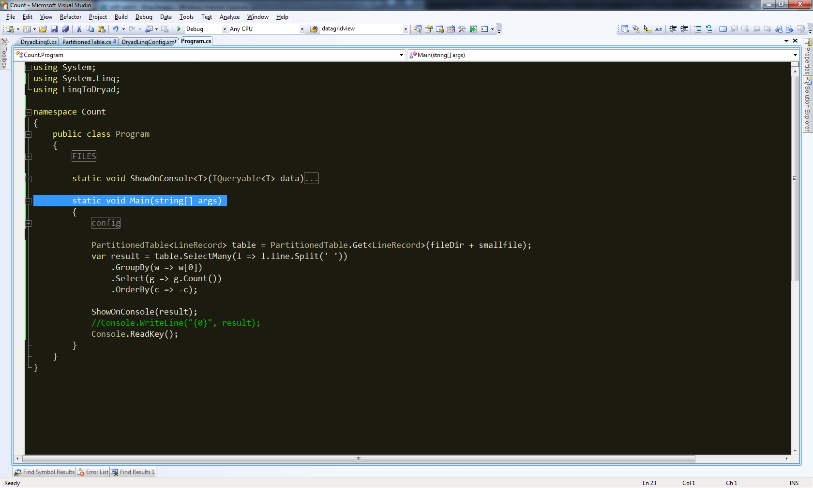
Demo

Slide 75
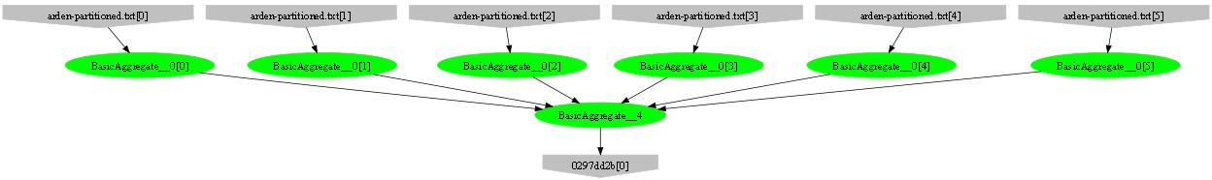
Example: counting lines
var table = PartitionedTable.Get<LineRecord>(file);
int count = table.Count();
Parse, Count
Sum

Slide 76
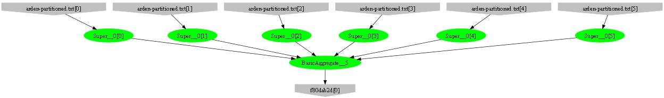
Example: counting words
var table = PartitionedTable.Get<LineRecord>(file);
int count = table .SelectMany(l => l.line.Split(‘ ‘))
.Count();
Parse, SelectMany, Count
Sum

Slide 77
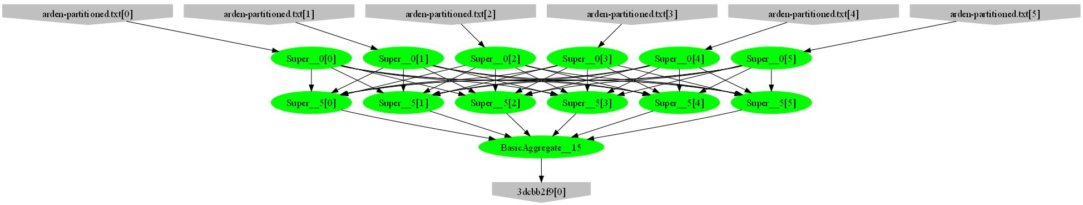
Example: counting unique words
var table = PartitionedTable.Get<LineRecord>(file);
int count = table .SelectMany(l => l.line.Split(‘ ‘))
.GroupBy(w => w)
.Count();
HashPartition
GroupBy;
Count

Slide 78
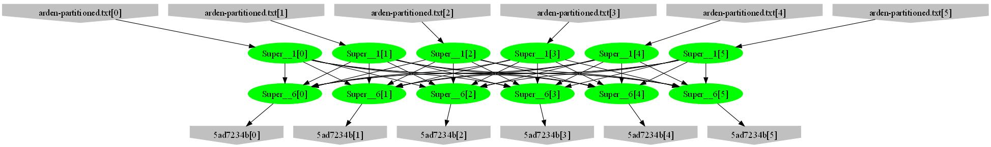
Example: word histogram
var table = PartitionedTable.Get<LineRecord>(file);
var result = table.SelectMany(l => l.line.Split(' '))
.GroupBy(w => w)
.Select(g => new { word = g.Key, count = g.Count() });
GroupBy
Count
HashPartition
GroupBy;
Count

Slide 79
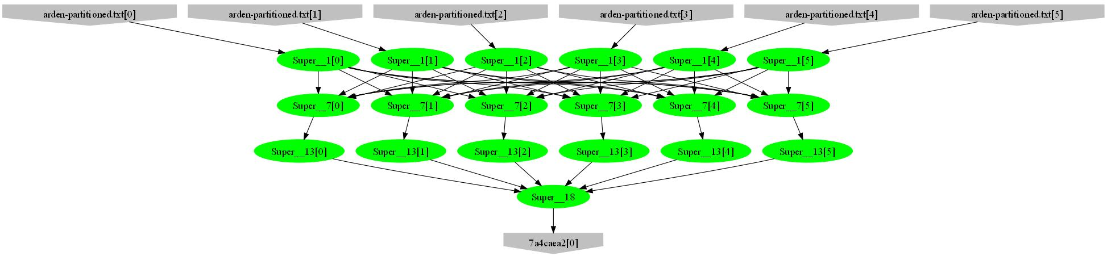
Example: high-frequency words
var table = PartitionedTable.Get<LineRecord>(file);
var result = table.SelectMany(l => l.line.Split(' '))
.GroupBy(w => w)
.Select(g => new { word = g.Key, count = g.Count() })
.OrderByDescending(t => t.count)
.Take(100);
Sort; Take
Mergesort; Take

Slide 80
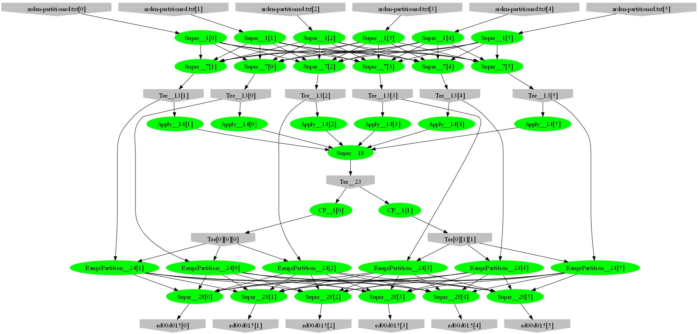
Example: words by frequency
var table = PartitionedTable.Get<LineRecord>(file);
var result = table.SelectMany(l => l.line.Split(' '))
.GroupBy(w => w)
.Select(g => new { word = g.Key, count = g.Count() })
.OrderByDescending(t => t.count);
Sample
Histogram
Broadcast
Range-partition
Sort

Slide 81
Example: Map-Reduce
public static IQueryable<S> MapReduce<T,M,K,S>(
IQueryable<T> input,
Func<T, IEnumerable<M>> mapper,
Func<M,K> keySelector,
Func<IGrouping<K,M>,S> reducer)
{
var map = input.SelectMany(mapper);
var group = map.GroupBy(keySelector);
var result = group.Select(reducer);
return result;
}

Slide 82
Map-Reduce Plan
M
M
M
M
M
M
M
map
Q
Q
Q
Q
Q
Q
Q
sort
G₁
G₁
G₁
G₁
G₁
G₁
G₁
groupby
map
M
R
R
R
R
R
R
R
reduce
D
D
D
D
D
D
D
distribute
G
R
MS
MS
MS
MS
MS
mergesort
groupby
X
G₂
G₂
G₂
G₂
G₂
partial aggregation
R
R
R
R
R
reduce
X
X
X
MS
MS
mergesort
static
dynamic
dynamic
G₂
G₂
groupby
reduce
S
S
S
S
S
S
R
R
reduce
A
A
A
X
X
consumer
T

Slide 83
Distributed Sorting Plan
DS
DS
DS
DS
DS
H
H
H
O
D
D
D
D
D
static
dynamic
dynamic
M
M
M
M
M
S
S
S
S
S

Slide 84
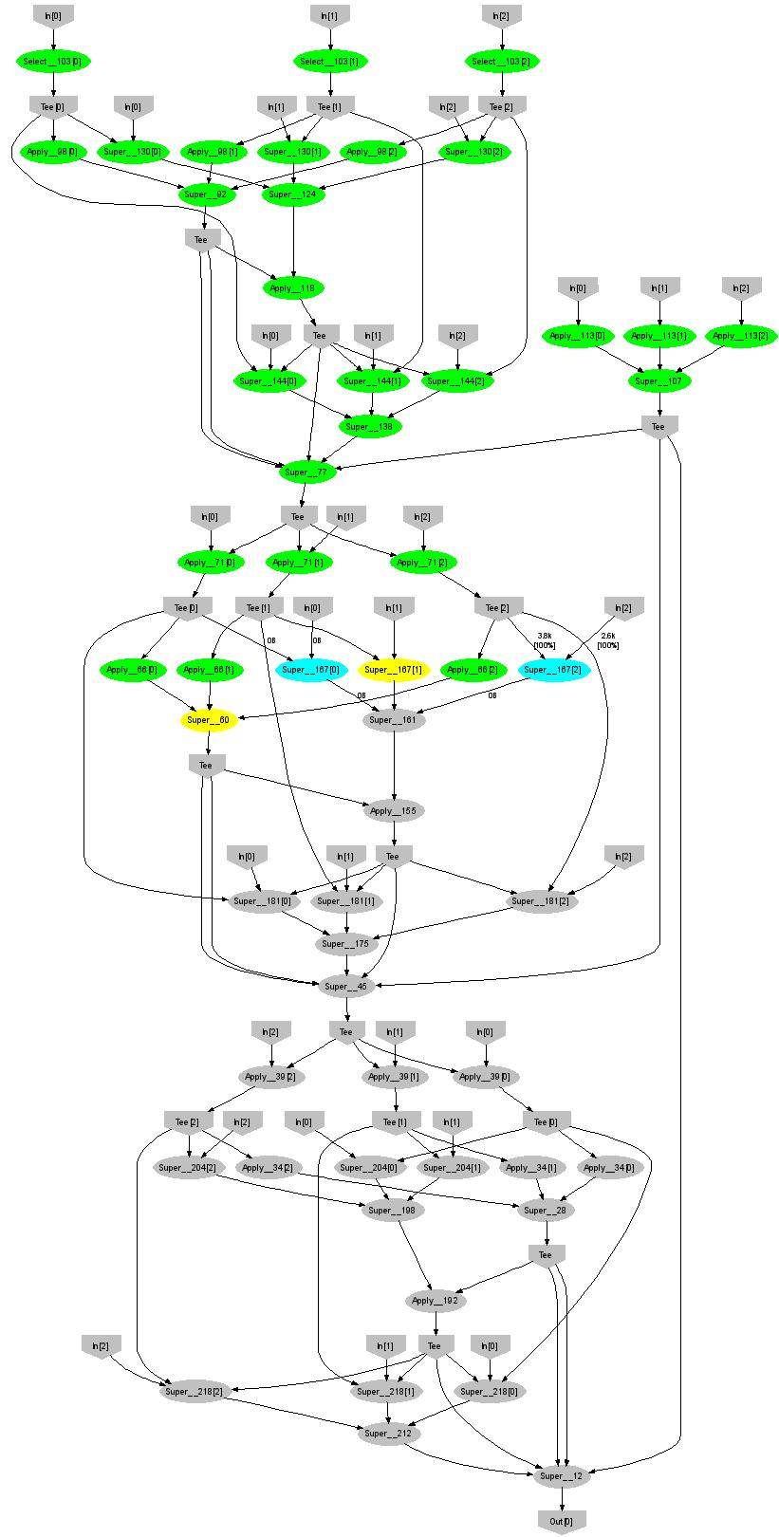
Expectation Maximization
160 lines
3 iterations shown
Notes:
More complicated, even iterative algorithms, can be implemented.

Slide 85
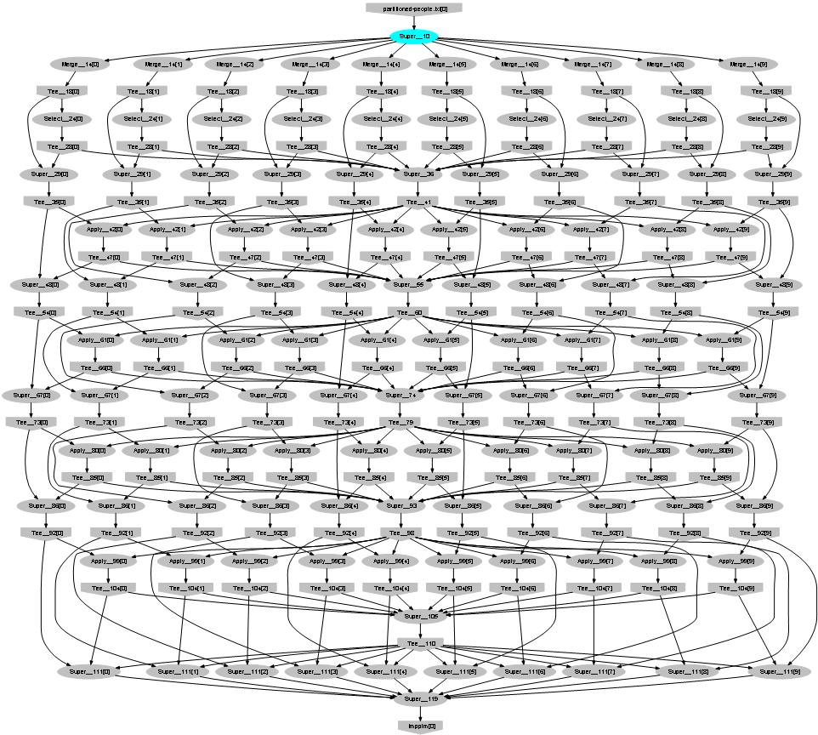
Probabilistic Index Maps
Images
features

Slide 86
Language Summary
Where
Select
GroupBy
OrderBy
Aggregate
Join

Slide 87
Think Parallel: Exercises
You are given a partitioned set of strings e.g., [ [to,be,or] [not,to,be] [that,is,the,question] ]
Computing is free
Data movement is expensive
Compute efficiently:
For each string its length
The total number of strings
The total number of characters
The longest string
The average string length
The standard deviation of the string length
The number of unique strings
The median length
The position of the longest string
for (int i=…)

Slide 88
LINQ System Architecture
Local machine
Execution engine
LINQ-to-obj
PLINQ
LINQ-to-SQL
LINQ-to-WS
LINQ to HPC
Flickr
Oracle
LINQ-to-XML
Your own
.Net program
LINQ Provider
Query
Objects

Slide 89
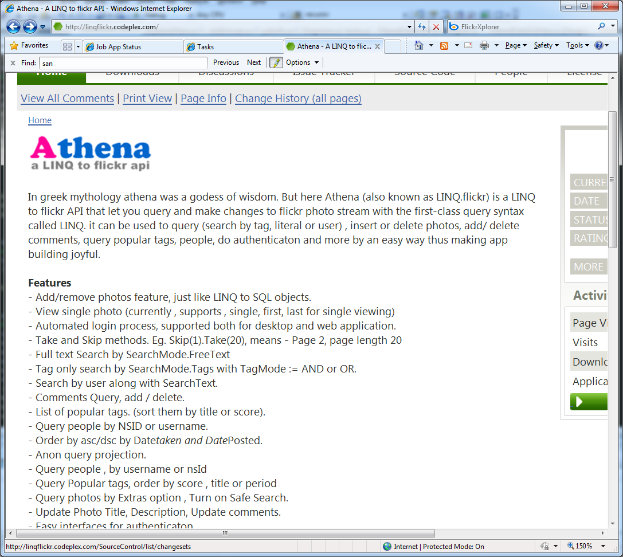
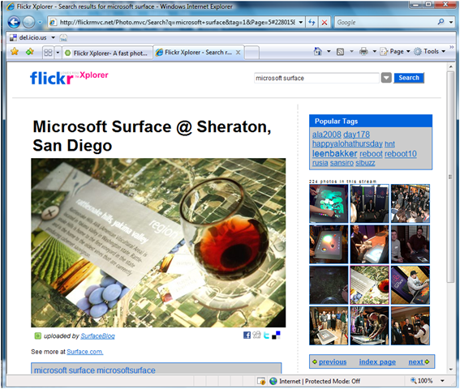
Aside: Linq to Flickr
Operates on collections of images
Executes on local machine & flickr
Another illustration of the power of LINQ

Slide 90
The LINQ to HPC Provider
Client machine
.Net
LINQ to HPC
Data center
Distributed query plan
Query Expr
Invoke
Query
Vertex code
Con- text
Input Tables
ToCollection
Dryad JM
Dryad Execution
.Net Objects
Output Table
iterator
Results
foreach
Output Tables

Slide 91
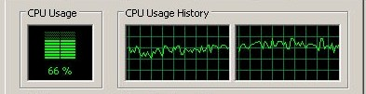
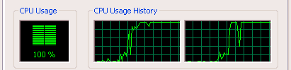
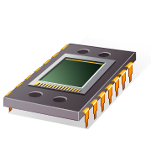
Using PLINQ
Query
LINQ to HPC
Local query
PLINQ
Notes:
At the bottom LINQ to HPC uses LINQ to run the computation in parallel on multiple cores.

Slide 92

LINQ Design
Strong typing for data very useful
Automatic serialization
Detect complex bugs
LINQ extensibility is very powerful
Running on very different runtimes
Managed code increases productivity by 10x10

Slide 93
More Tricks of the trade
Asynchronous operations hide latency
Management using distributed state machines
Logging state transitions for debugging
Compression trades-off bandwidth for CPU

Slide 94
BUILDING ON LINQ to HPC
Applications
Language
Distributed Execution
Cluster storage
Cluster services
Health service
Windows Server
Windows Server
Windows Server
Windows Server

Slide 95
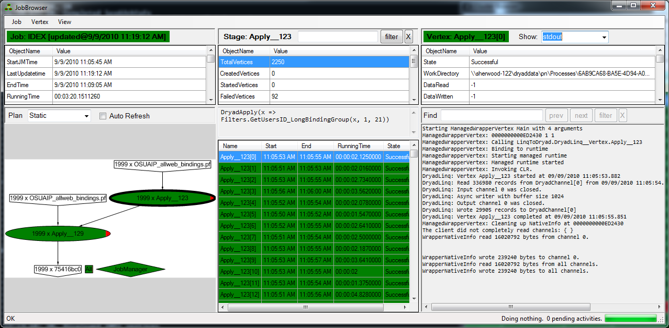
Job Visualization

Slide 96
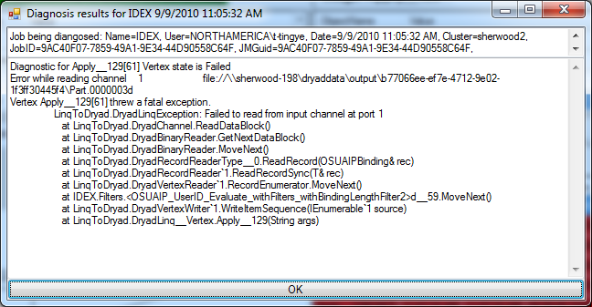
Failure Diagnostics

Slide 97
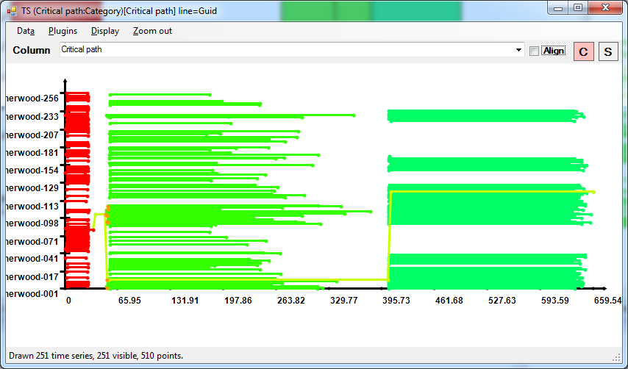
Job Schedule

Slide 98
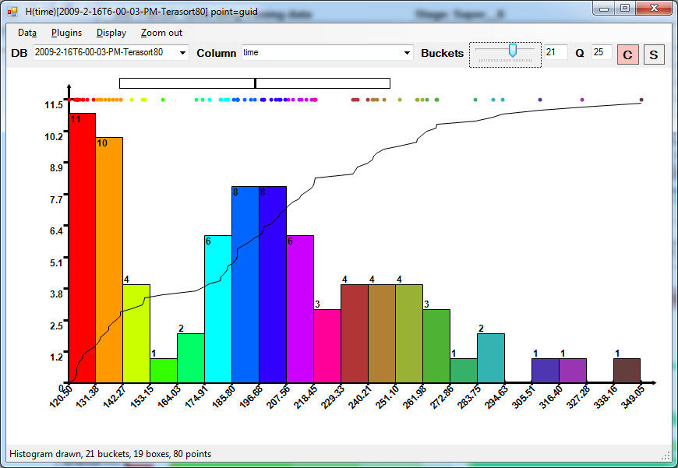
Running time distribution

Slide 99
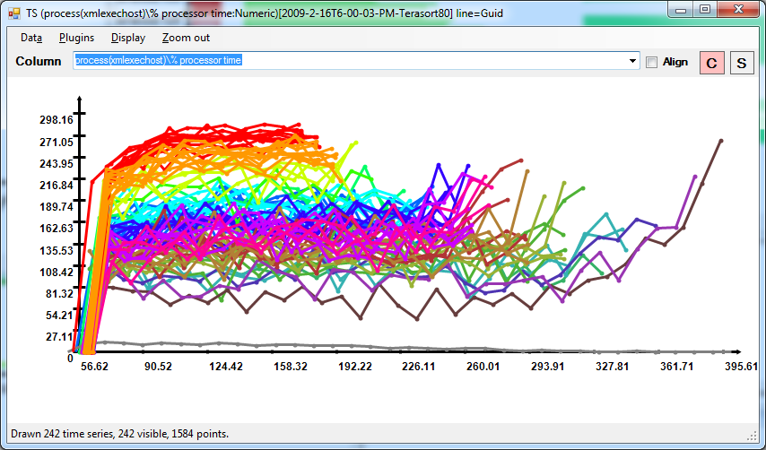
CPU Utilization

Slide 100

So, What Good is it For?

Slide 101
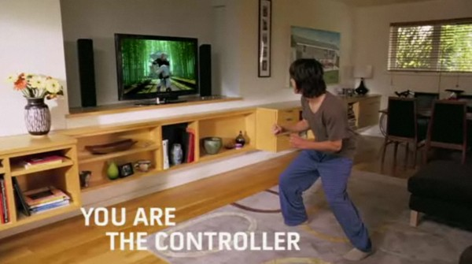
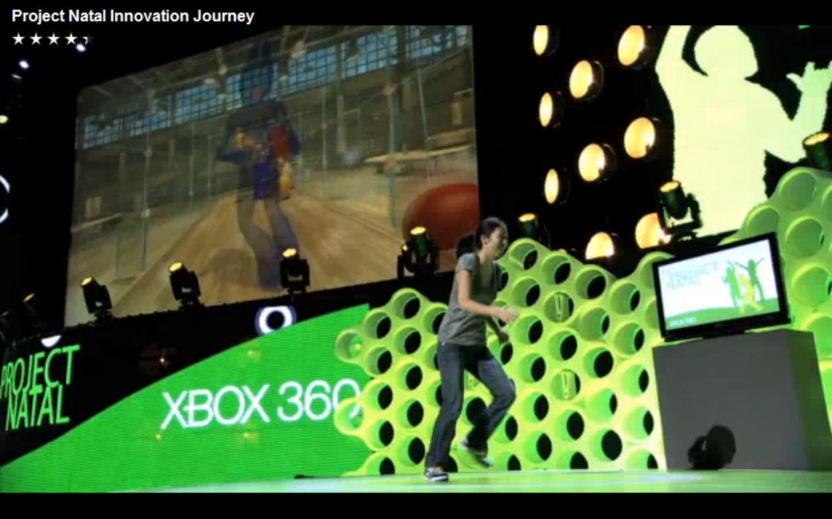
Application: Kinect Training

Slide 102
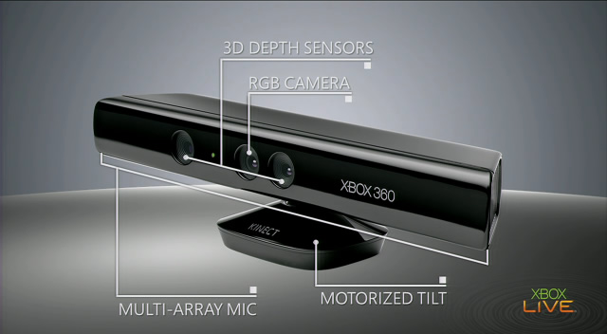
Input device

Slide 103
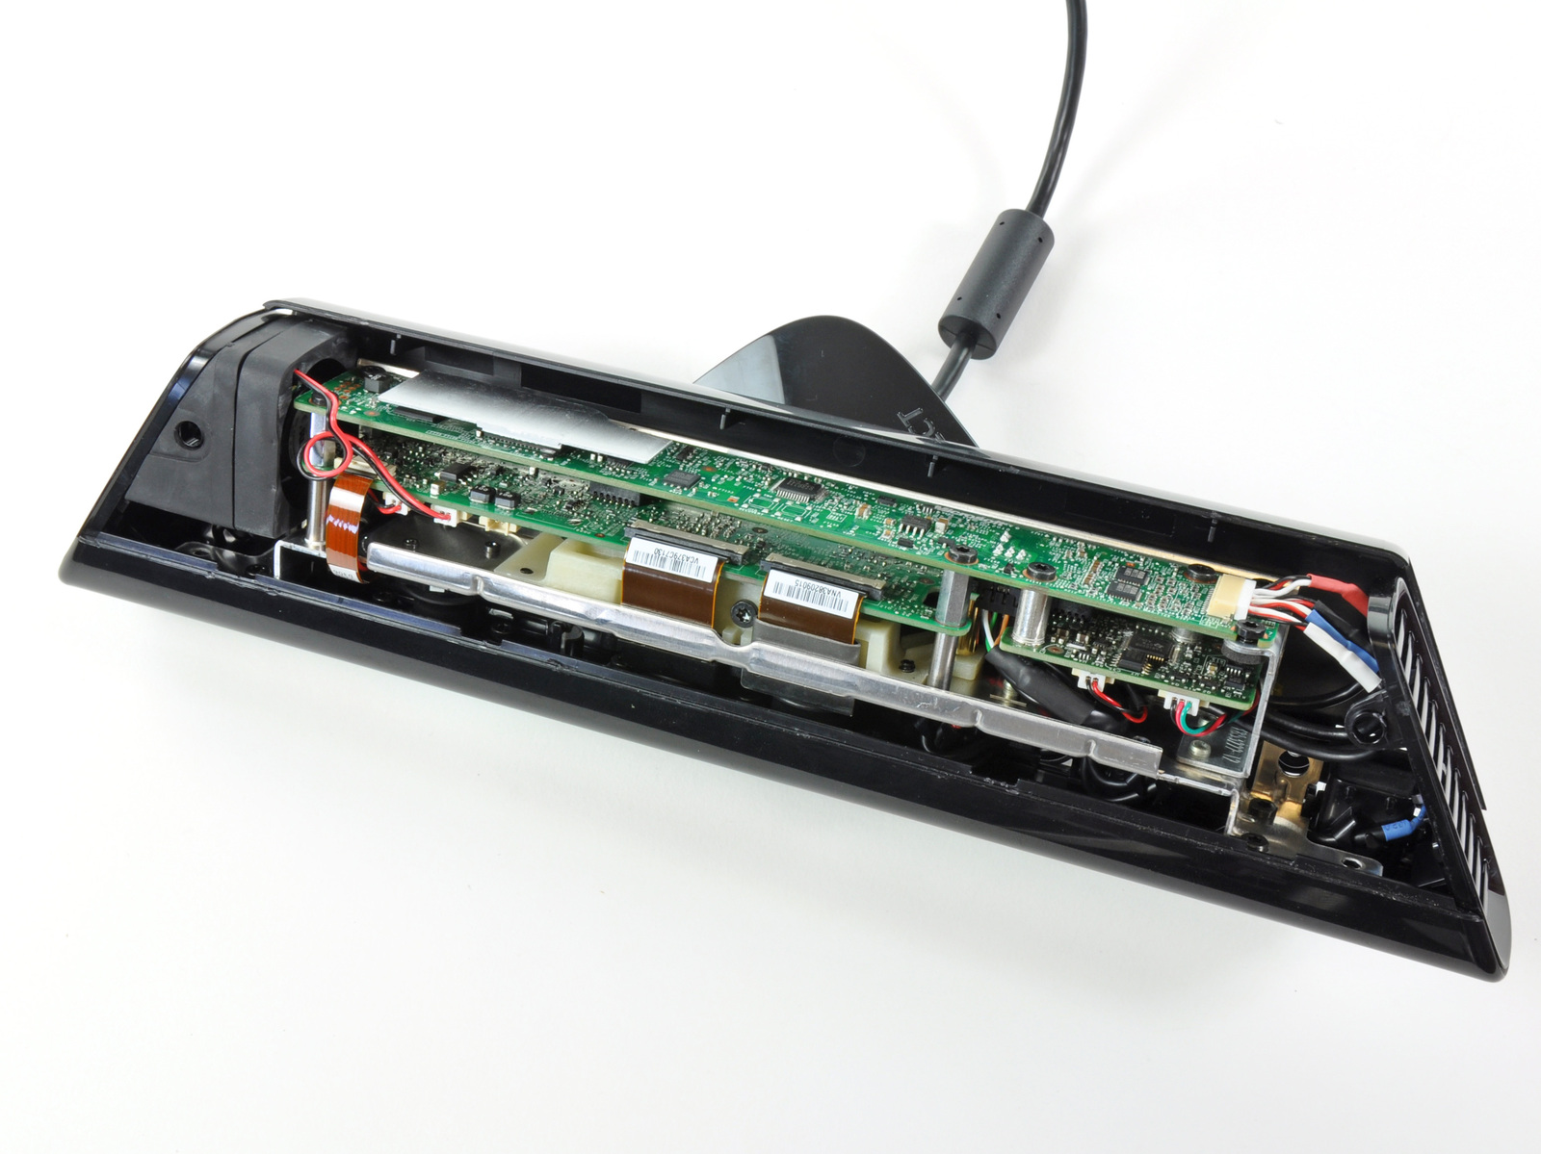
The Innards
Source: iFixit

Slide 104
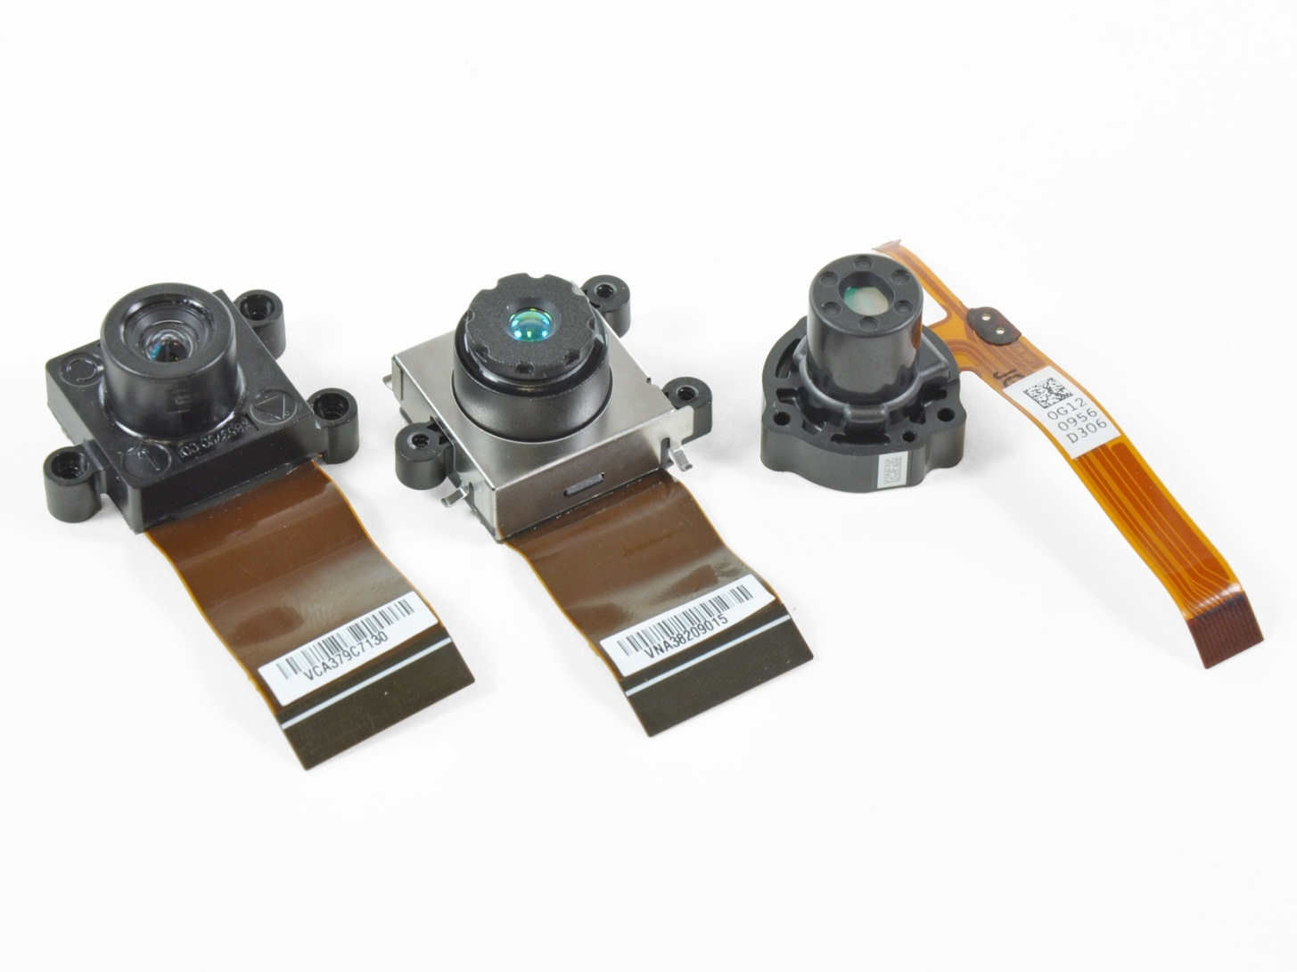
The vision system
RGB camera
IR camera
IR laser projector
Source: iFixit

Slide 105
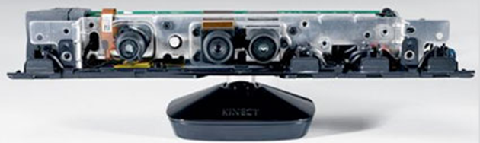
The audio sensors
4 channel multi-array microphone
Time-locked with console to remove game audio

Slide 106
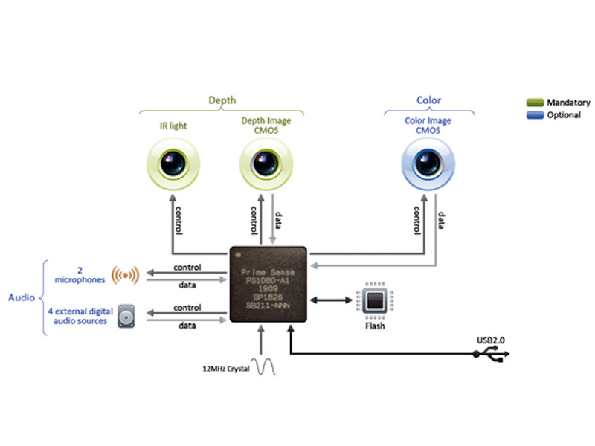
Prime Sense Chip
Xbox Hardware Engineering dramatically improved upon Prime Sense reference design performance
Micron scale tolerances on large components
Manufacturing process to yield ~1 device / 1.5 seconds

Slide 107
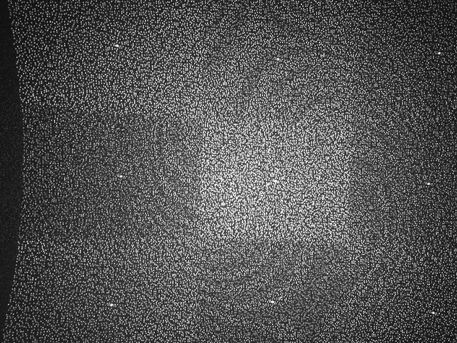
Projected IR pattern
Source: www.ros.org

Slide 108

Depth computation
Source: http://nuit-blanche.blogspot.com/2010/11/unsing-kinect-for-compressive-sensing.html

Slide 109


Vision Input: Depth Map + RGB

Slide 110
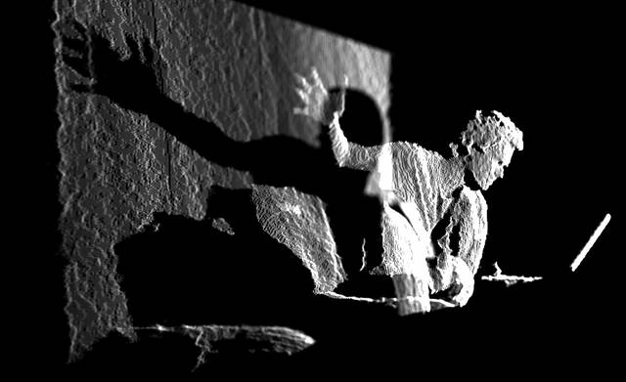
Depth map
Source: www.insidekinect.com

Slide 111
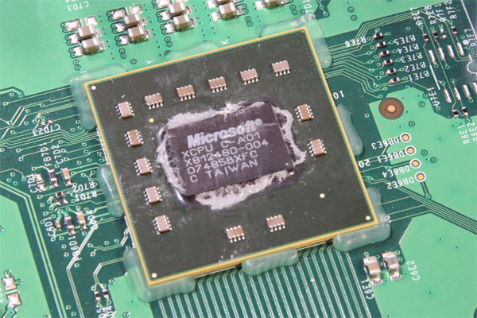
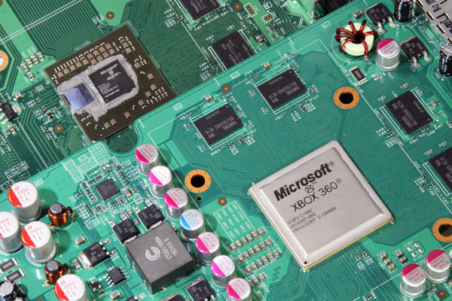
XBox 360 Hardware
Triple Core PowerPC 970, 3.2GHz
Hyperthreaded, 2 threads/core
500 MHz ATI graphics card
DirectX 9.5
512 MB RAM
2005 performance envelope
Must handle
real-time vision AND
a modern game
Source: http://www.pcper.com/article.php?aid=940&type=expert

Slide 112

Human pose estimation
x
y
z
θ
Notes:
…
As with many tasks in computer vision, the problem may seem fairly easy to a human. However…

Slide 113





Why is it hard?

Slide 114






Skeletal Tracking Pipeline
Sensor
Depth map
Background segmentation
Player separation
Body Part Classifier
Body Part Identification
Skeleton

Slide 115
The Classifier
Classifier
Input
Depth map
Runs on GPU @ 320x240
Output
Body parts

Slide 116


Motion Capture

Slide 117





Ground Truth Data
Use synthetic data (3D avatar model)
Inject noise

Slide 118

Learn from Data
Training examples
Machine learning
Classifier

Slide 119
Kinect Training
Decision
forest
Tens of millions of examples needed
Machine learning
DryadLINQ
Dryad
Cluster

Slide 120

Highly efficient parallellization
machine
time

Slide 121
The End

Slide 122















The Roaring ‘60s

Slide 123














The other ‘60s
Spacewars
PDP/8
ARPANET
Multics
Time-sharing
(defun factorial (n)
(if (<= n 1) 1
(* n (factorial (- n 1)))))
Virtual memory
OS/360

Slide 124



What about the 2010’s?

Slide 125
Layers
Applications
Programming Languages and APIs
Resource Management
Scheduling
Distributed Execution
Operating System
Caching and Synchronization
Storage
Identity & Security
Networking

Slide 126









Pieces of the Global Computer
And many, many more…

Slide 127

This lecture

Slide 128


The cloud
“The cloud” is evolving rapidly
New frontiers are being conquered
The face of computing will change forever
There is still a lot to be done
You might do it!

Slide 129

Conclusions
Cluster
LINQ
Dryad
=
129
Notes:
We believe that Dryad and LINQ to HPC are a great foundation for cluster computing.

Slide 130

Software Availability

Slide 131
Bibliography (1)
Dryad: Distributed Data-Parallel Programs from Sequential Building Blocks
Michael Isard, Mihai Budiu, Yuan Yu, Andrew Birrell, and Dennis Fetterly
European Conference on Computer Systems (EuroSys), Lisbon, Portugal, March 21-23, 2007
DryadLINQ: A System for General-Purpose Distributed Data-Parallel Computing Using a High-Level Language
Yuan Yu, Michael Isard, Dennis Fetterly, Mihai Budiu, Úlfar Erlingsson, Pradeep Kumar Gunda, and Jon Currey Symposium on Operating System Design and Implementation (OSDI), San Diego, CA, December 8-10, 2008
Hunting for problems with Artemis Gabriela F. Creţu-Ciocârlie, Mihai Budiu, and Moises Goldszmidt USENIX Workshop on the Analysis of System Logs (WASL), San Diego, CA, December 7, 2008
DryadInc: Reusing work in large-scale computations Lucian Popa, Mihai Budiu, Yuan Yu, and Michael Isard Workshop on Hot Topics in Cloud Computing (HotCloud), San Diego, CA, June 15, 2009
Distributed Aggregation for Data-Parallel Computing: Interfaces and Implementations,
Yuan Yu, Pradeep Kumar Gunda, and Michael Isard,
ACM Symposium on Operating Systems Principles (SOSP), October 2009
Quincy: Fair Scheduling for Distributed Computing Clusters
Michael Isard, Vijayan Prabhakaran, Jon Currey, Udi Wieder, Kunal Talwar, and Andrew Goldberg ACM Symposium on Operating Systems Principles (SOSP), October 2009

Slide 132
Bibliography (2)
Autopilot: Automatic Data Center Management, Michael Isard, in Operating Systems Review, vol. 41, no. 2, pp. 60-67, April 2007
Distributed Data-Parallel Computing Using a High-Level Programming Language, Michael Isard and Yuan Yu, in International Conference on Management of Data (SIGMOD), July 2009
SCOPE: Easy and Efficient Parallel Processing of Massive Data Sets Ronnie Chaiken, Bob Jenkins, Per-Åke Larson, Bill Ramsey, Darren Shakib, Simon Weaver, and Jingren Zhou, Very Large Databases Conference (VLDB), Auckland, New Zealand, August 23-28 2008
Incorporating Partitioning and Parallel Plans into the SCOPE Optimizer, Jingren Zhou, Per-Åke Larson, and Ronnie Chaiken, in Proc. of the 2010 ICDE Conference (ICDE’10).
Nectar: Automatic Management of Data and Computation in Datacenters, Pradeep Kumar Gunda, Lenin Ravindranath, Chandramohan A. Thekkath, Yuan Yu, and Li Zhuang, in Proceedings of the 9th Symposium on Operating Systems Design and Implementation (OSDI), October 2010

